Slide 1
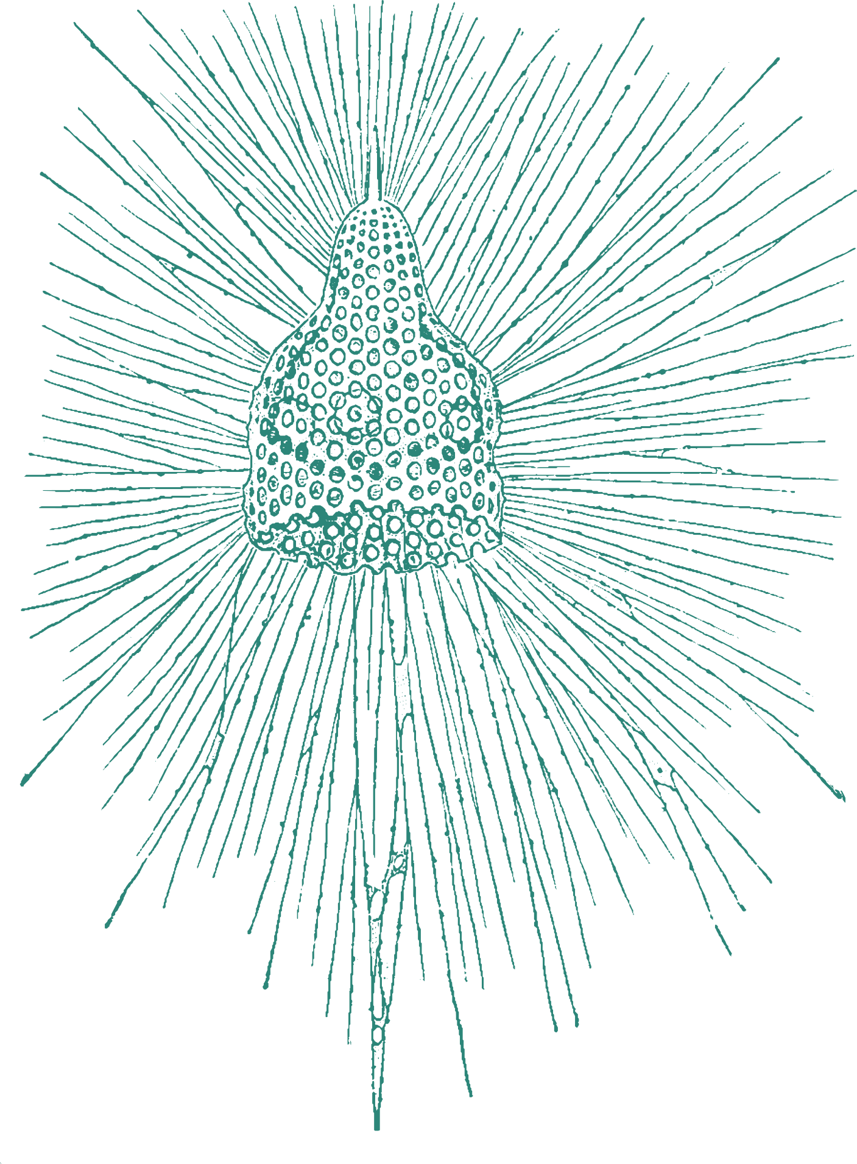
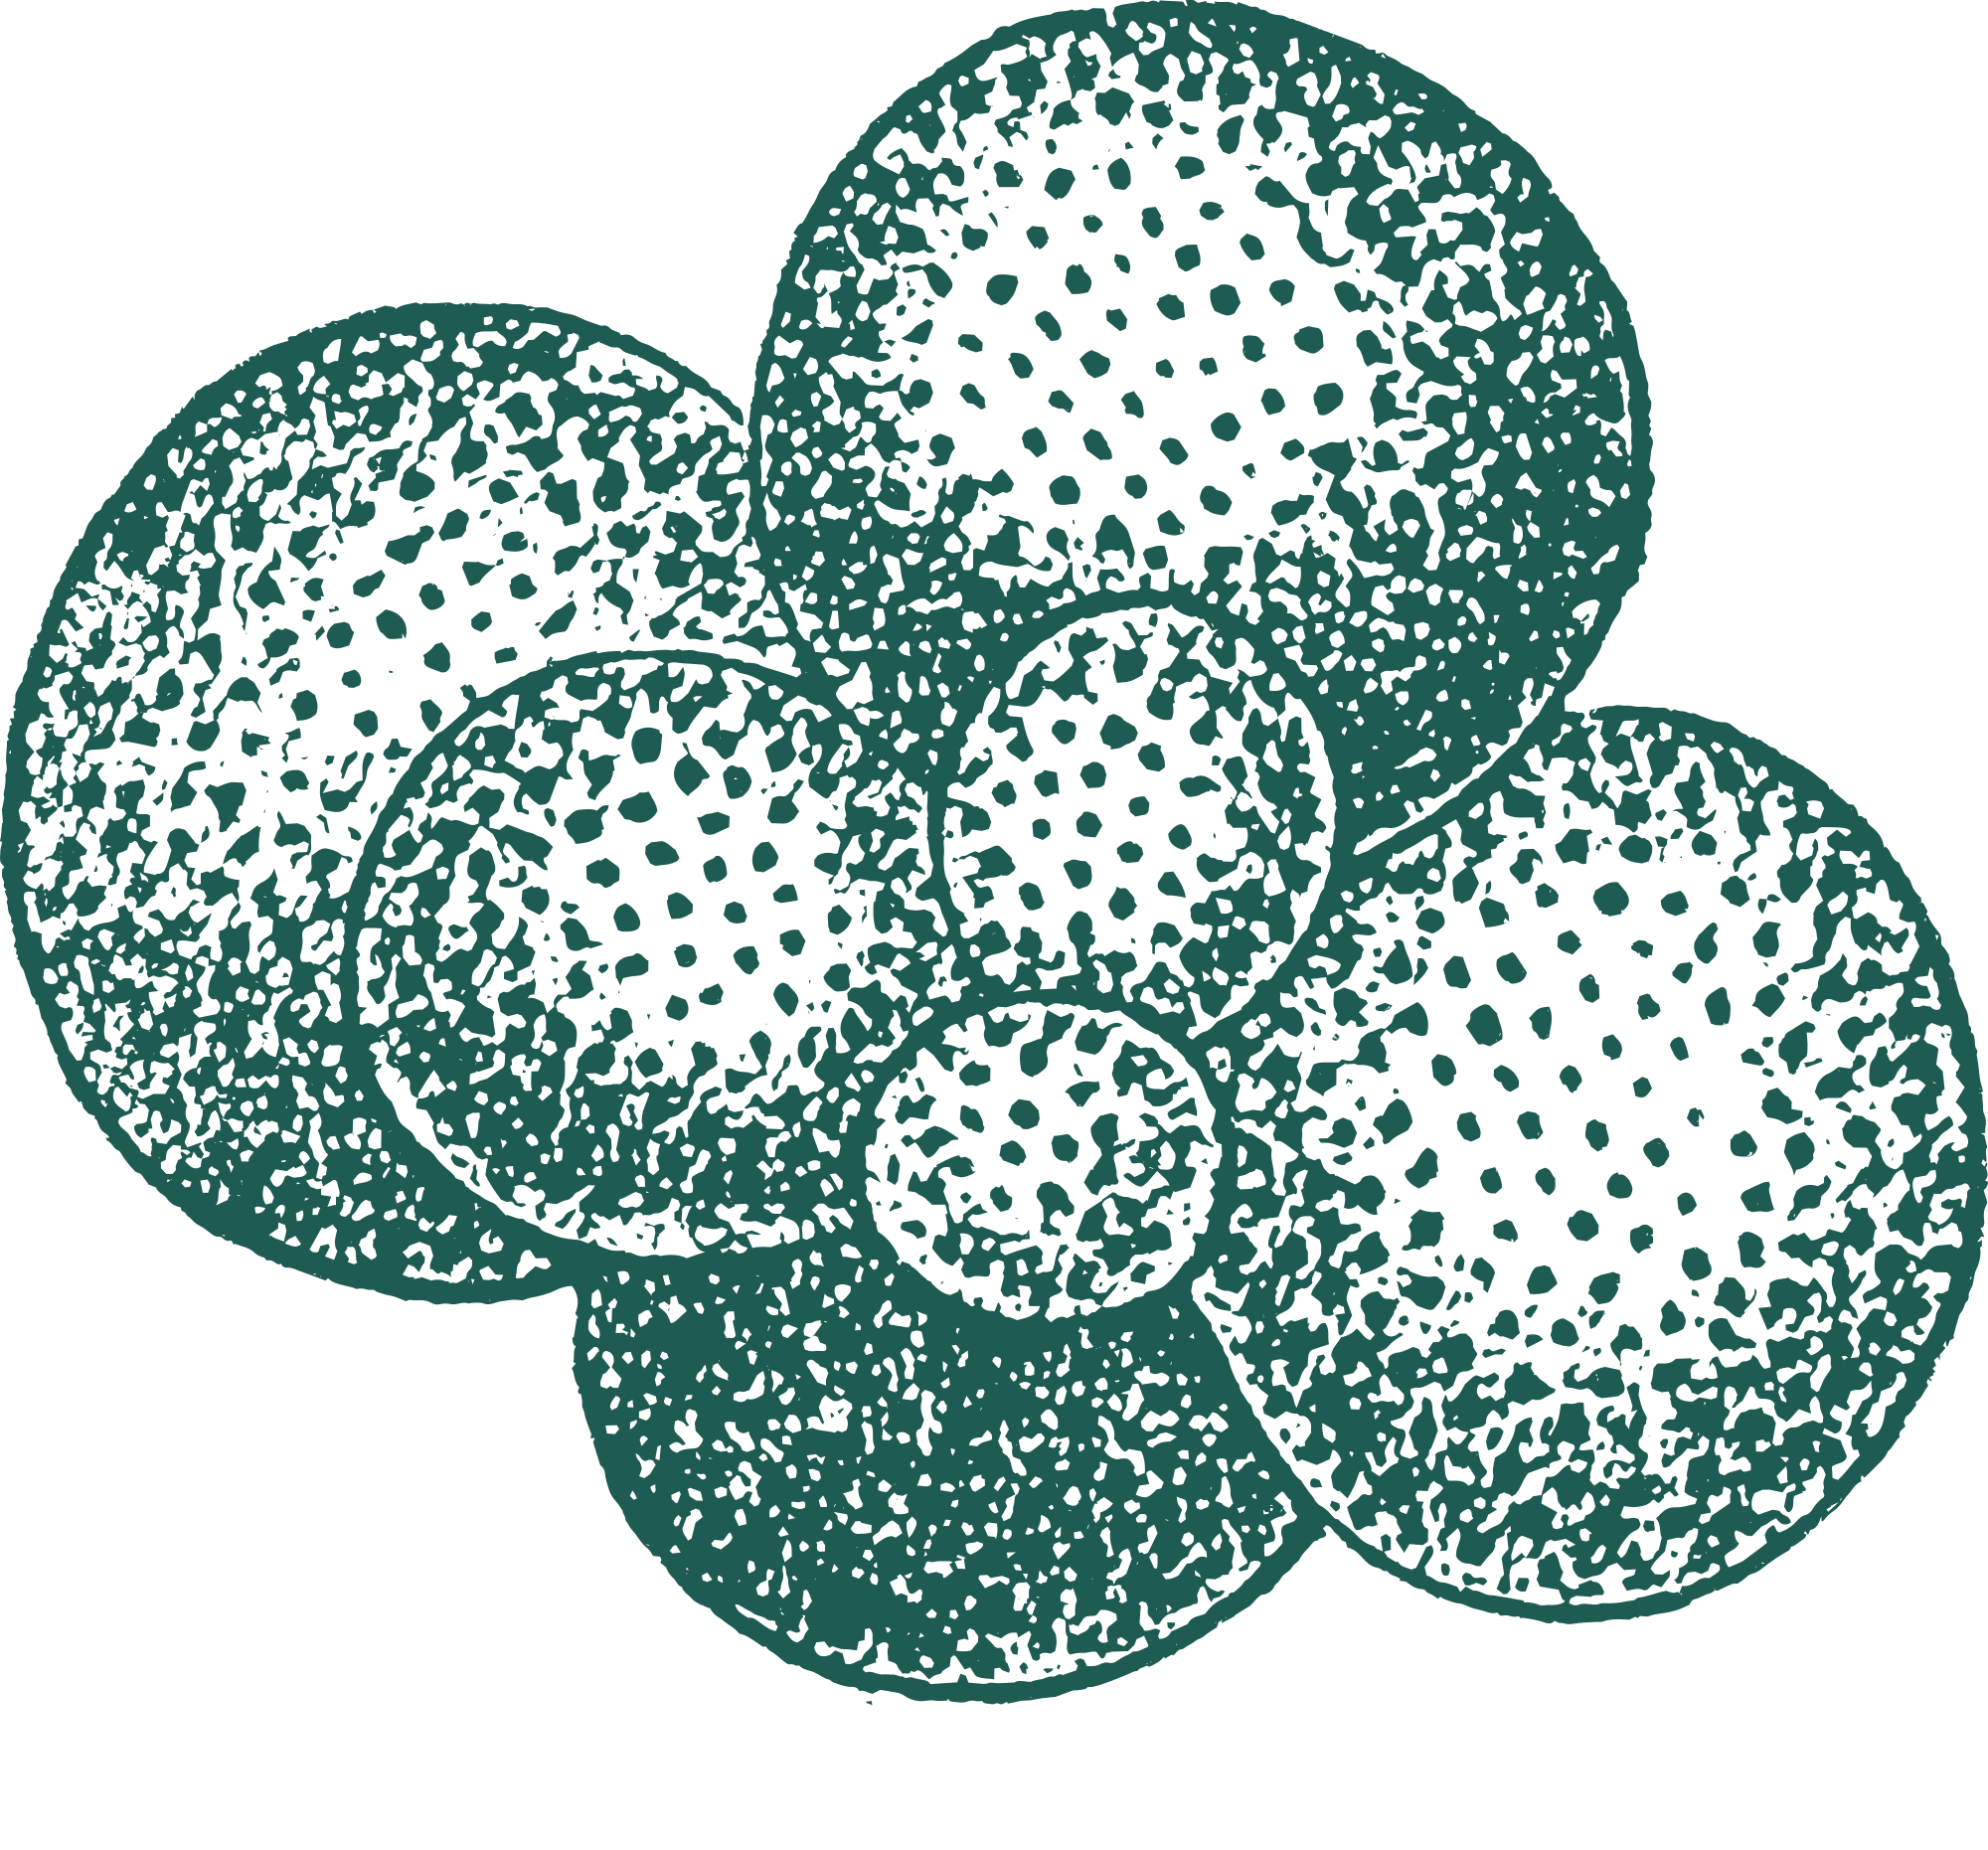



Workshop on Molecular Phylogeny
The Life of Retaria

Slide 2
GOALS OF THE WORKSHOP
Basics of molecular phylogenies
Data availabilities
Sequence alignments & tree topology
Time tree theory and inference

Slide 3



TEAM OF TEACHERS
Guidelines for time tree inference
Topology inference
Time tree theory

Slide 4
WHAT YOU WILL NEED
I – A question you want to address ->Our case study will be the phylogeny of the Globigerinoides genus.
II – DNA sequences editing program such as SEAVIEW (https://doua.prabi.fr/software/seaview), MEGA (https://www.megasoftware.net/) or Aliview (https://ormbunkar.se/aliview/). These programs are free.
III – All other ressources can be found online

Slide 5
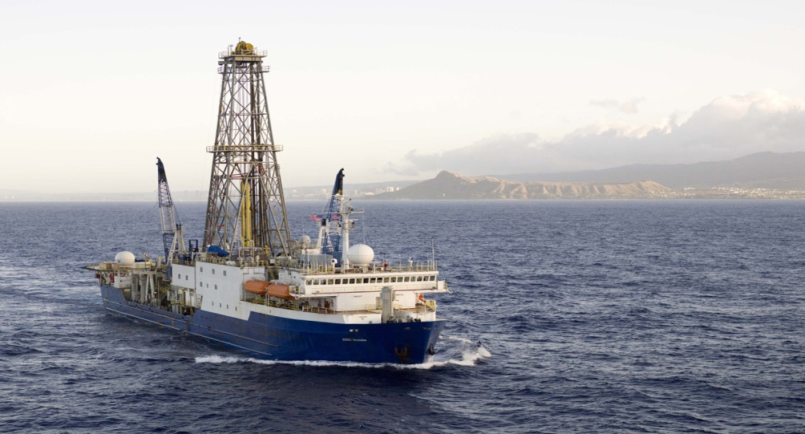

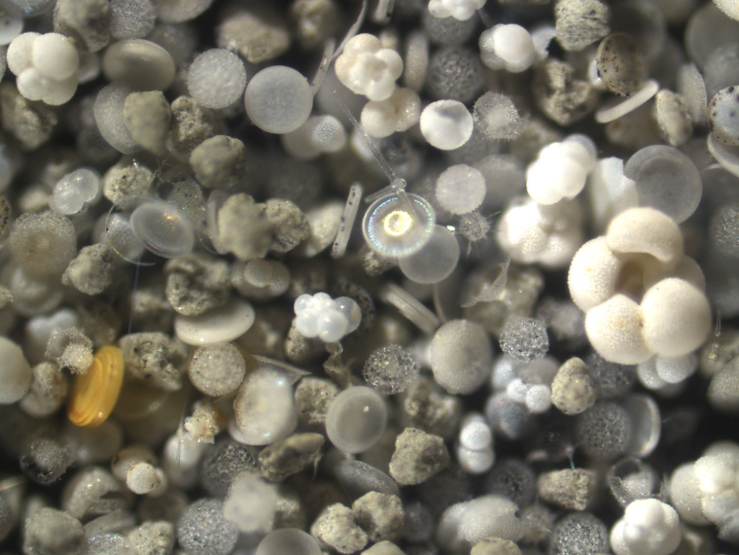
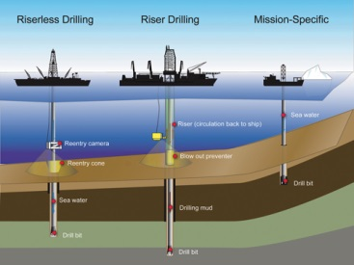
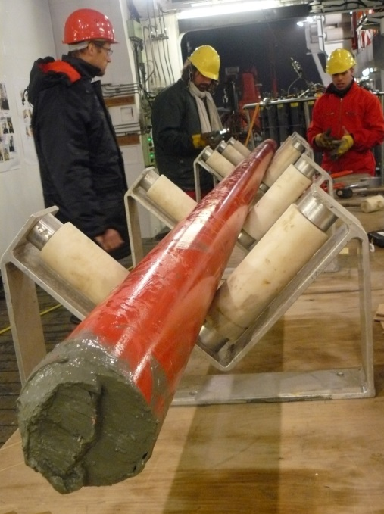
MICROPALEONTOLOGY
Fossil assemblage
https://www.flickr.com/photos/cazphoto/3030365020/sizes/l/
http://www.iodp.org/
International Ocean Discovery Program (IODP)

Slide 6
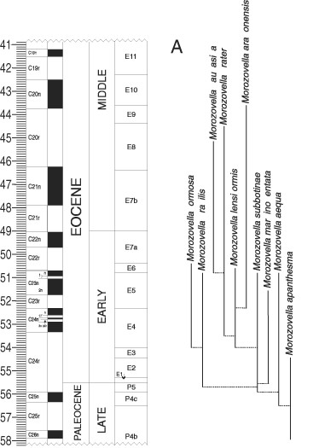
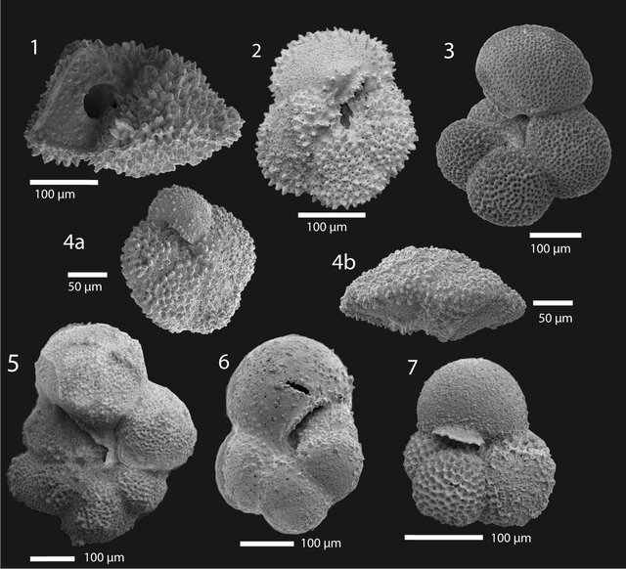
MICROPALEONTOLOGY
- Morphospecies boundaries?
- Phylogenetically informative characters?
Jehle et al. (2015)
Aze et al. (2011)

Slide 7

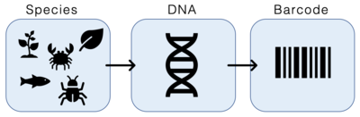
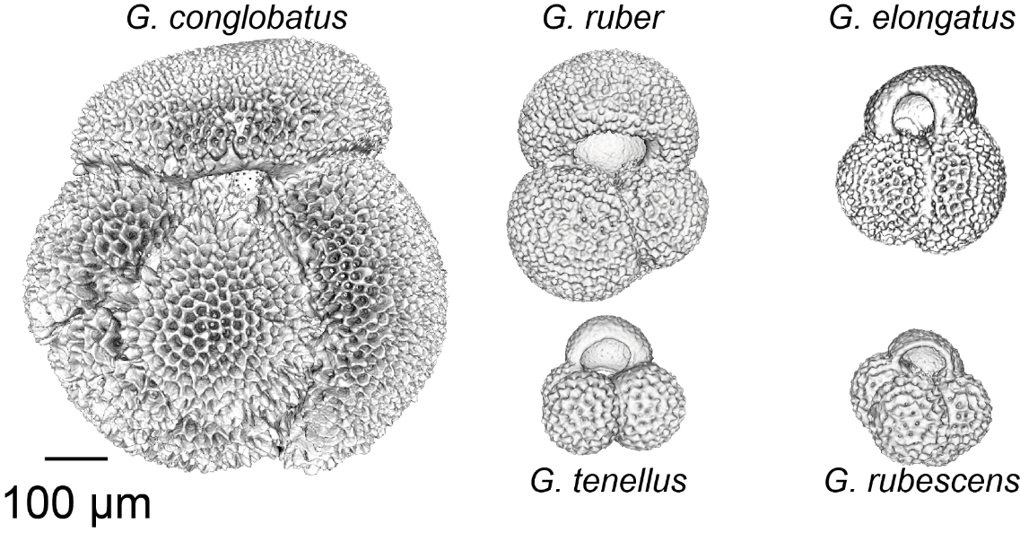
BARCODING & PHYLOGENY
Barcoding animal Life (Herbert et al., 2003)
Foraminifera barcode: ~1000 bp fragment
located at the end of the Small Sub Unit ribosomal DNA
(SSU rDNA) or 18S

Slide 8
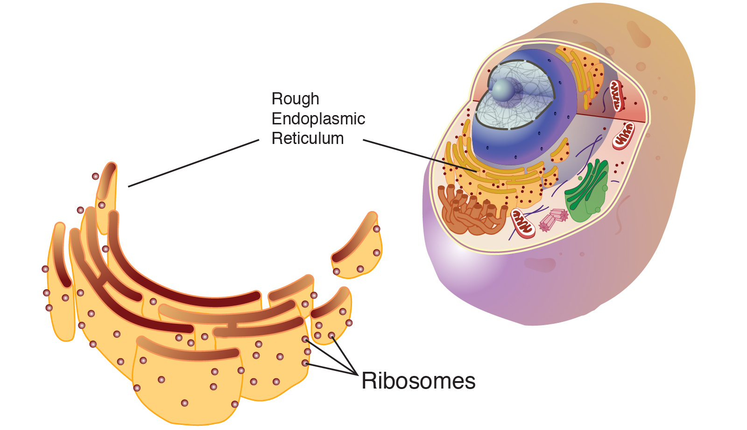
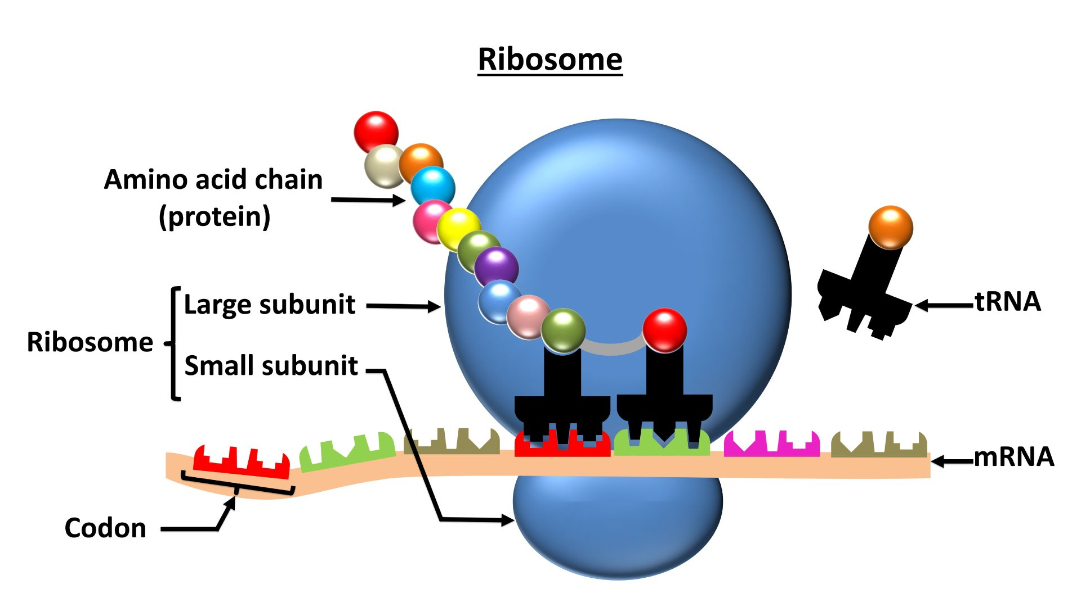
BARCODING & PHYLOGENY
What are ribosomes?
https://www.qeios.com/read/732718
https://www.beckman.de/resources/sample-type/cell-organelles/ribosomes
Ribosomes ➔ Translation of mRNA into protein
➔ Fundamental for Survival ➔  Selection pressure ➔  evolutionary rates ➔ Great for phylogenies with « deep nodes »

Slide 9
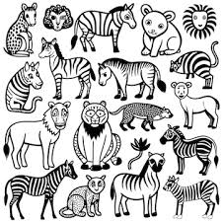


BARCODING & PHYLOGENY
Why are molecular data (DNA) are so practical to study evolution?
Morphology
DNA
DNA sequences are considerably easier to process by computer.
DNA standardized by nature (only 4 nucleotides or base).
Universal among all organisims.
Sequence data are easier to share and compare, even between markedly different organisms.
Dataset
….ATGCTTCCTA….
….TACGACGAA….
….TAACGTACAA….
….TGCCCTAATC….
….TCAGCATTAC….
Processing

Slide 10
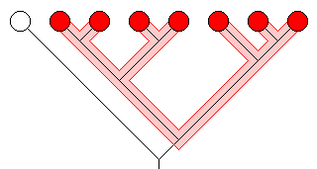
BARCODING & PHYLOGENY
Taxa of the lowest rank (leaves)
Outgroup
Ingroup
Clade: taxon of a higher rank
Order of
branching
Branches
Nodes
The most recent common ancestor
(hypothetical)
Root
Phylogenetic tree: graphical representation of the relationship among several taxa

Slide 11
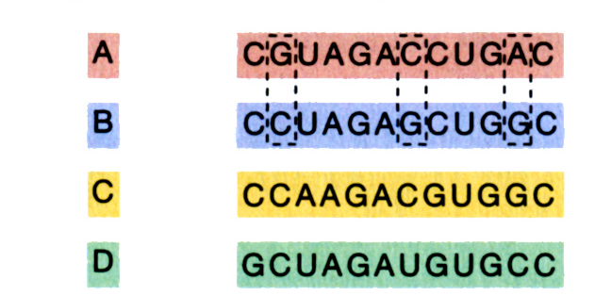
BARCODING & PHYLOGENY
We consider the state of the genetic code - the sequence of nucleotides – to generate a topology
Organism Sequence
Alignment
DNA analysis can be carried out either at the level of individual bases or codons (triplets of bases coding for different aminoacids)

Slide 12
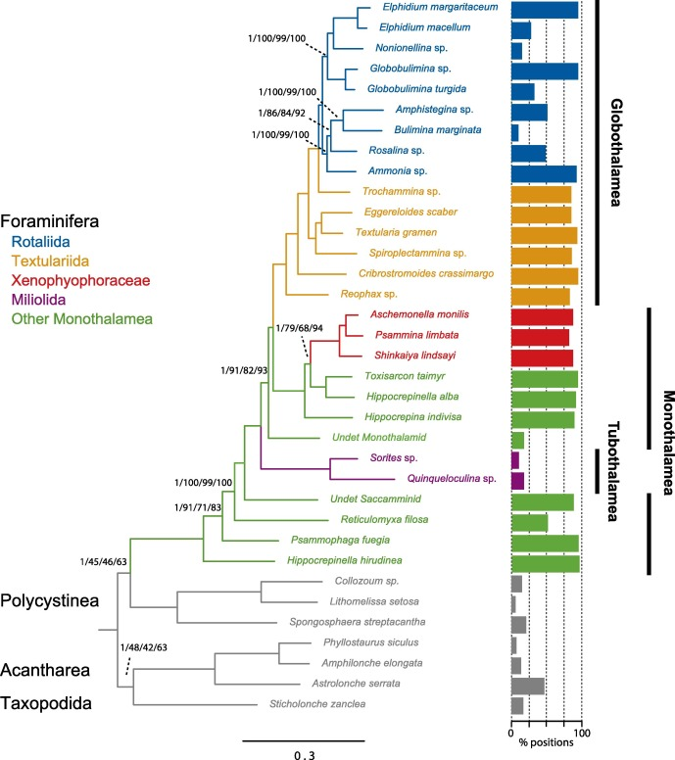
BARCODING & PHYLOGENY
BRANCH
SUPPORT
Phylogeny of foraminifera rooted on other Retaria
INGROUP
OUTGROUP
Substitution per site
Sierra et al. (2022)

Slide 13
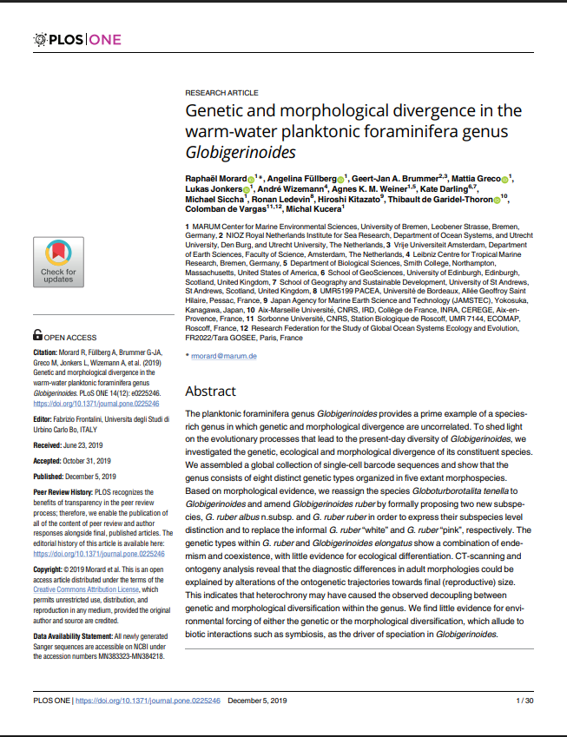
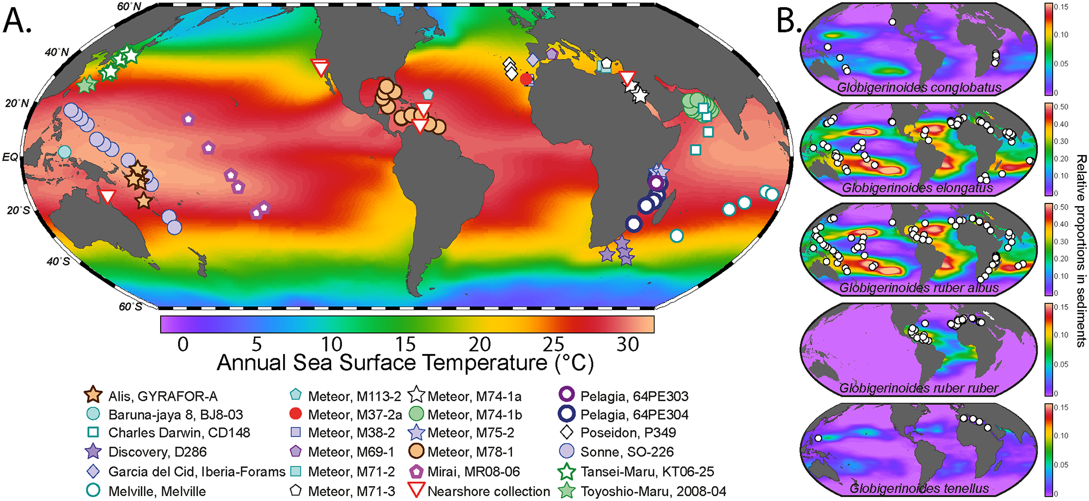
THE CASE STUDY
This study investigates how genetic and morphological diversity arise within the planktonic foraminifera genus Globigerinoides
→ genetically distinct species can appear morphologically similar and vice versa
GOALS:
→ to clarify species boundaries
→ to explore the drivers of evolutionary divergence
Notes:
Work on the speech!!!!!!

Slide 14
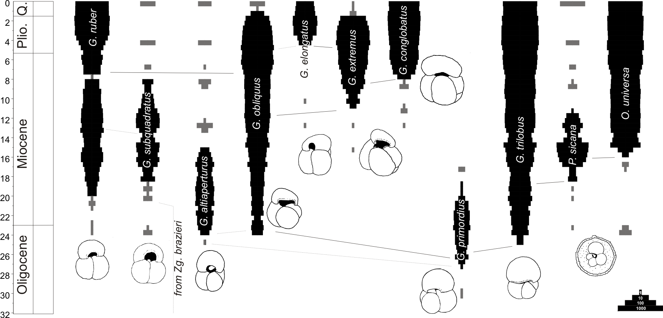
THE CASE STUDY
Fossil occurences
Fossil cladogram
G. rubescens
G. tenellus
G.elongatus
G. conglobatus
G.ruber
Aurahs et et al. (2011)

Slide 15
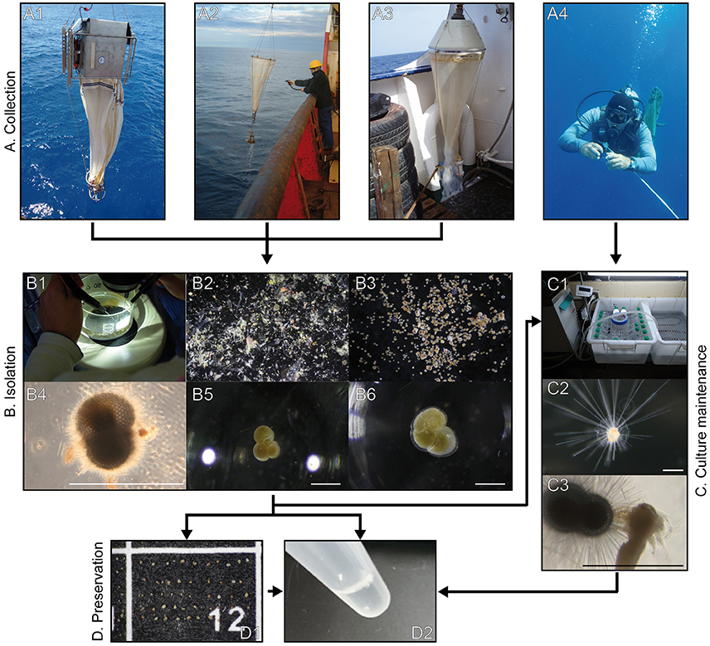
DATA AVAILABILITIES
How to obtain sequences?
Or consult public databases for data availabilities:
NCBI (https://www.ncbi.nlm.nih.gov/nuccore)
Manual curation

Slide 16
WORKFLOW
Retrieve and curate data (NCBI, Curated databases, Literrature search)
I
Align sequences
(SEAVIEW: Align ➔ Align all)
II
Infer the tree topology
(SEAVIEW: Trees ➔ PhyML ➔ Run)
III

Slide 17
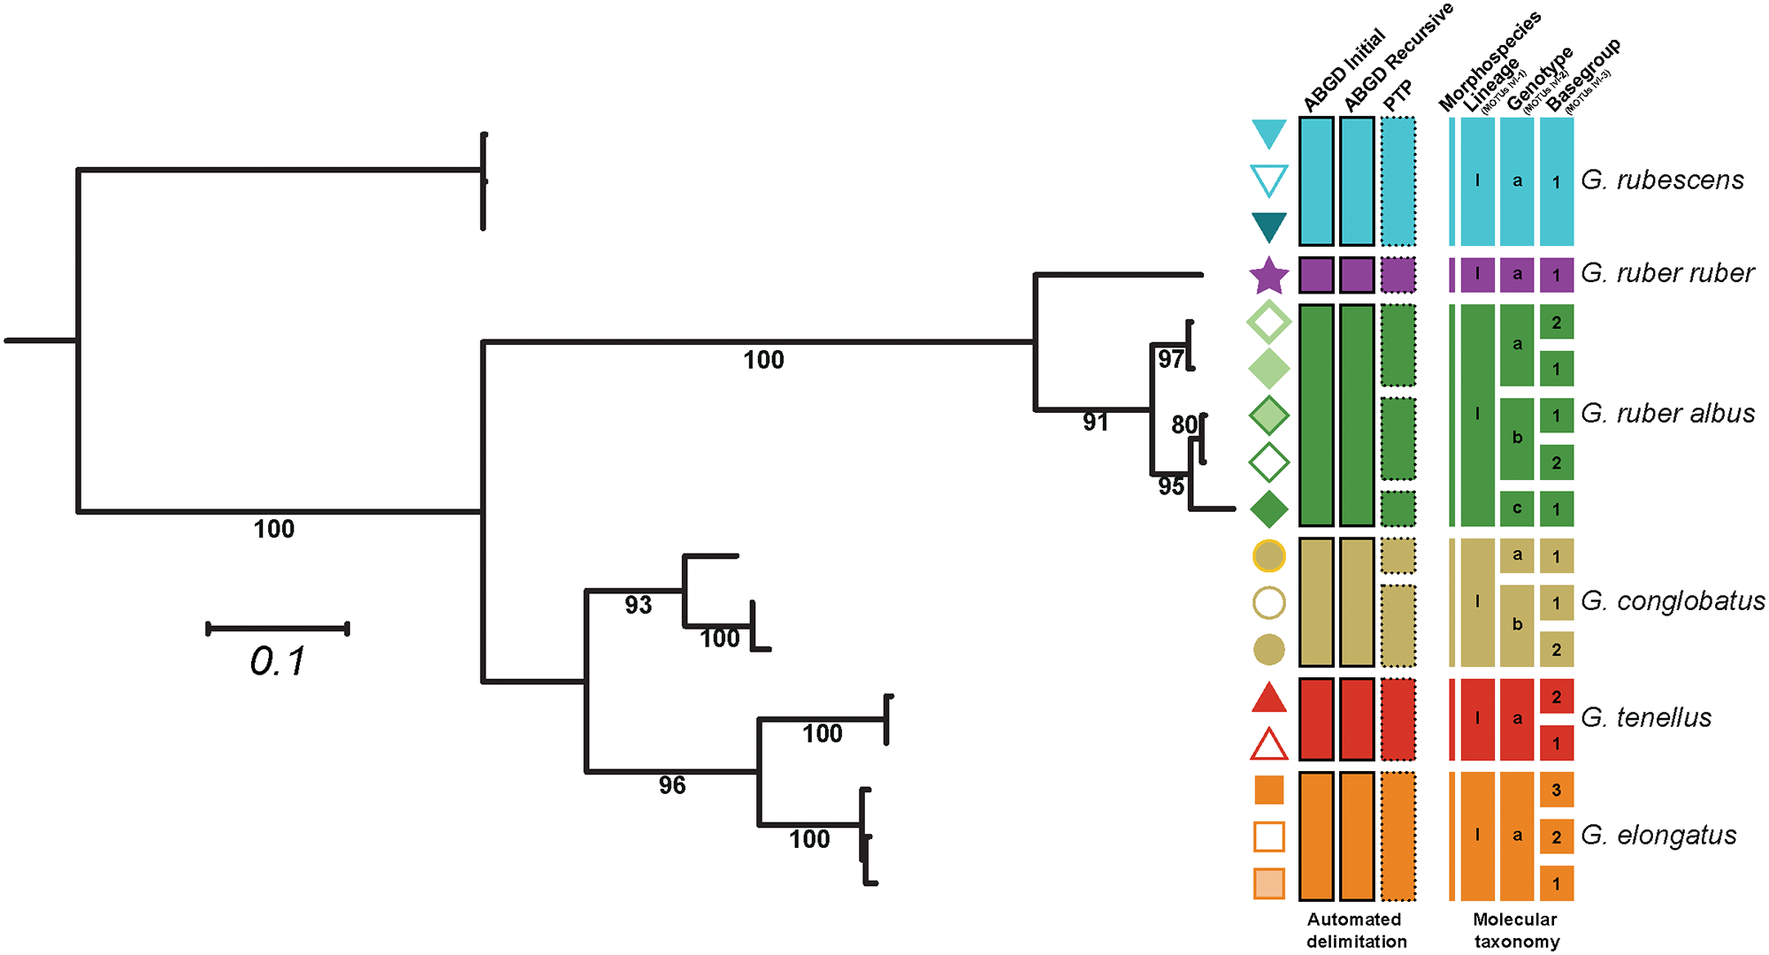
ET VOILA!
Fossil cladogram
G. rubescens
G. tenellus
G.elongatus
G. conglobatus
G.ruber
?

